Slide 1
Polygon Selection Strategy for Generalized MV Coordinates

Slide 2
Key Points
We know the location of support points
We don’t know the shape of the support polygon
Generalized MV coordinate (or Barycentric Coordinate in general) is sensitive to the shape of the polygon.
If all the support points are part of convex problem, there is a unique sequencing.
If the polygon is nonconvex, in some cases there is decision to be made for deciding which polygon to choose.
Unless we know the polygon, we can’t compute weights

Slide 3
Generalized MV Coordinates
It is a form of generalized Barycentric coordinate
It works for some cases of non-convex polygon
- The polygon should be Star Shaped Polygon
- Point G (or mean value coordinate) should be in the kernel of the polygon i.e. it should be visible from every point of all the edges

Slide 4
Star Polygon Strategy
Objective: Draw a polygon such that all points of the edges are visible from G (center of gravity projection)
Algorithm
Calculate the counter-clockwise angle of all support points with horizontal line passing through G (angles are in degrees)
Sort the angles in increasing order
If (Max_Angle – Min_Angle > 180), follow further from point 4
else G is outside polygon
Polygon will start with the vertex having smallest angle and next vertex of polygon will be next smallest angle and so on
Calculate the weights for all the vertices using MV coordinate

Slide 5
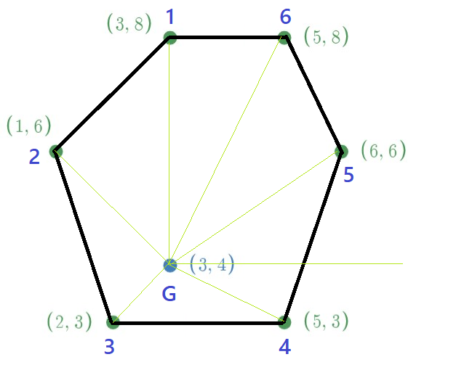
Index | Angles | Sorted Index | Sorted Angles
1 | 90.0 | 5 | 33.7
2 | 135.0 | 6 | 63.4
3 | 225.0 | 1 | 90.0
4 | 333.4 | 2 | 135.0
5 | 33.7 | 3 | 225.0
6 | 63.4 | 4 | 333.4
Index | Original MV Coordinates | MV Coordinates after Sorting | Sorted Index
1 | 4.5 | 6.6 | 5
2 | 14.0 | 3.1 | 6
3 | 47.2 | 4.5 | 1
4 | 24.6 | 14.0 | 2
5 | 6.6 | 47.2 | 3
6 | 3.1 | 24.6 | 4
Difference between minimum angle and maximum angle = 333.4-33.7
= 299.7 >180
G inside Polygon
Sequence of polygon formation: 5-6-1-2-3-4-5

Slide 6
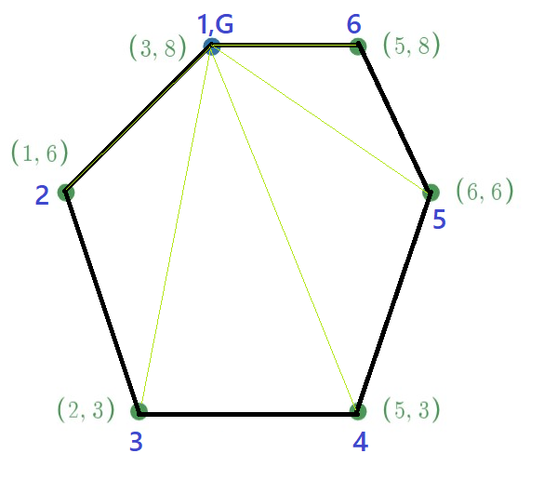
Index | Angles | Sorted Index | Sorted Angles
1 | 0.0 | 6 | 0.0
2 | 225.0 | 1 | 0.0
3 | 258.7 | 2 | 225.0
4 | 291.8 | 3 | 258.7
5 | 326.3 | 4 | 291.8
6 | 0.0 | 5 | 326.3
Index | Original MV Coordinates | MV Coordinates after Sorting | Sorted Index
1 | 100 | 0 | 6
2 | 0 | 100 | 1
3 | 0 | 0 | 2
4 | 0 | 0 | 3
5 | 0 | 0 | 4
6 | 0 | 0 | 5
Difference between minimum angle and maximum angle = 326.3-0
= 326.3 >180
G ∈ Polygon
Sequence of polygon formation: 6-1-2-3-4-5-6

Slide 7
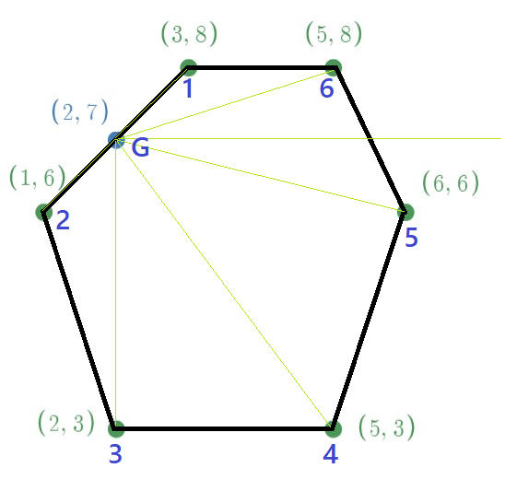
Index | Angles | Sorted Index | Sorted Angles
1 | 45.0 | 6 | 18.4
2 | 225.0 | 1 | 45.0
3 | 270.0 | 2 | 225.0
4 | 306.9 | 3 | 270.0
5 | 346.0 | 4 | 306.9
6 | 18.4 | 5 | 346.0
Index | Original MV Coordinates | MV Coordinates after Sorting | Sorted Index
1 | 50 | 0 | 6
2 | 50 | 50 | 1
3 | 0 | 50 | 2
4 | 0 | 0 | 3
5 | 0 | 0 | 4
6 | 0 | 0 | 5
Difference between minimum angle and maximum angle = 346-18.4
= 327.6 >180
G ∈ Polygon
Sequence of polygon formation: 6-1-2-3-4-5-6

Slide 8
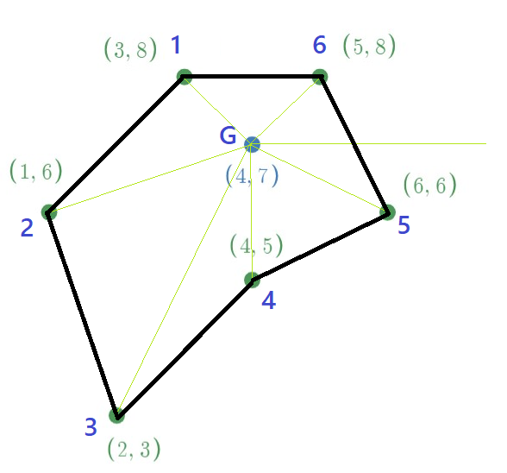
Index | Angles | Sorted Index | Sorted Angles
1 | 135.0 | 6 | 45.0
2 | 198.4 | 1 | 135.0
3 | 243.4 | 2 | 198.4
4 | 270.0 | 3 | 243.4
5 | 333.4 | 4 | 270.0
6 | 45.0 | 5 | 333.4
Index | Original MV Coordinates | MV Coordinates after Sorting | Sorted Index
1 | 29.7 | 31.5 | 6
2 | 8.5 | 29.7 | 1
3 | 3.8 | 8.5 | 2
4 | 11.1 | 3.8 | 3
5 | 15.5 | 11.1 | 4
6 | 31.5 | 15.5 | 5
Difference between minimum angle and maximum angle = 333.4-45
= 288.4 >180
G ∈ Polygon
Sequence of polygon formation: 6-1-2-3-4-5-6

Slide 9
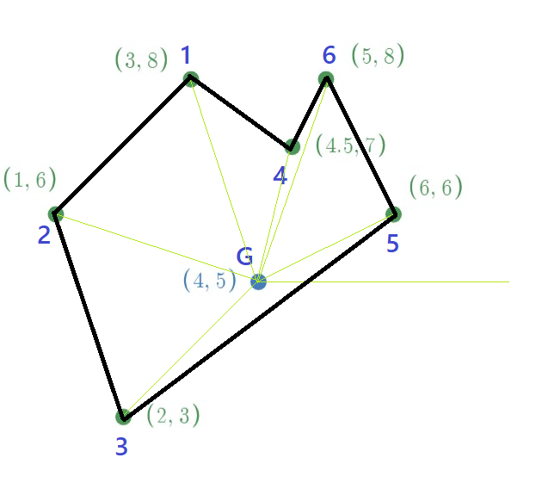
Index | Angles | Sorted Index | Sorted Angles
1 | 108.4 | 5 | 26.6
2 | 161.6 | 6 | 71.6
3 | 225.0 | 4 | 76.0
4 | 76.0 | 1 | 108.4
5 | 26.6 | 2 | 161.6
6 | 71.6 | 3 | 225.0
Index | Original MV Coordinates | MV Coordinates after Sorting | Sorted Index
1 | 6.7 | 47.1 | 5
2 | 9.1 | 2.3 | 6
3 | 27.1 | 2.6 | 4
4 | 50.5 | 4.0 | 1
5 | 0.5 | 5.7 | 2
6 | 6.1 | 38.4 | 3
Difference between minimum angle and maximum angle = 225-26.6
= 198.4 >180
G ∈ Polygon
Sequence of polygon formation: 5-6-4-1-2-3-5

Slide 10
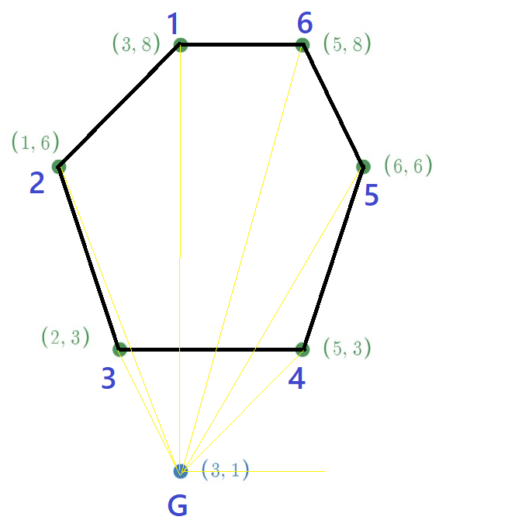
Index | Angles | Sorted Index | Sorted Angles
1 | 90.0 | 4 | 45.0
2 | 111.8 | 5 | 59.0
3 | 116.6 | 6 | 74.1
4 | 45.0 | 1 | 90.0
5 | 59.0 | 2 | 111.8
6 | 74.1 | 3 | 116.6
Index | Original MV Coordinates | MV Coordinates after Sorting | Sorted Index
1 | 6.9 | 30.8 | 4
2 | 6.3 | 6.4 | 5
3 | 44.2 | 5.4 | 6
4 | 30.8 | 6.9 | 1
5 | 6.4 | 6.3 | 2
6 | 5.4 | 44.2 | 3
Difference between minimum angle and maximum angle = 116.9-45
= 71.9 <180
G outside polygon
We can’t calculate MV coordinate for this polygon (table above gives wrong result)

